Slide 1
Vocabulary for Ecological Succession
Succession: the process of one ecological community replacing another
Colonization: the movement of an organism into a new environment
Pioneer species: species that colonize previously uncolonized land; typically the first species in an environment
Tend to be very hardy species
Ex: Lichens, a composite organism consisting of a fungus and algae

Slide 2
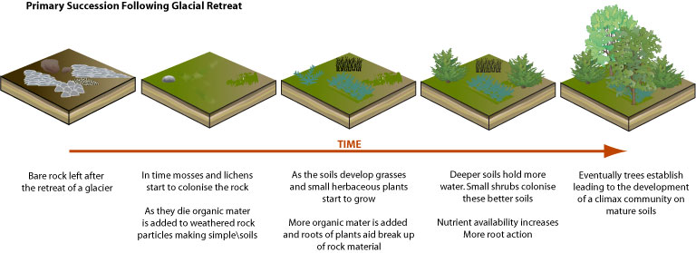
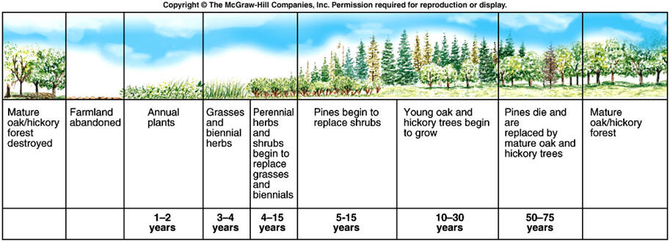
Secondary Succession

Slide 3
