Slide 1
4/16/2011
Objective: Be able to describe how hydrogen bonding is responsible for cohesion, adhesion, surface tension, and high specific heat of water
Warm-Up:
Draw a water molecule and label the positively charged region and the negatively charged region.

Slide 2
Properties of Water

Slide 3
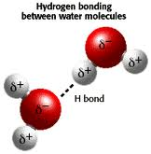

Slide 4
“Hydrogen bonds kept it together”
Hydrogen bonds are the key to water’s unusual behavior
Water is polar—one part has a negative charge and one part has a positive charge
Opposites attract!
Hydrogen bonding occurs between the negatively charged oxygen of one molecule and the positively charged hydrogen of another water molecule

Slide 5
“Water bunched together”
Water molecules stick to one another!
Cohesion is the word used to describe this property of water
Cohesion is brought to you by hydrogen bonding

Slide 6
“The Liquid Stuck to the Glass”
Water can stick to some surfaces
Adhesion is the word used to describe this property of water
The surface of glass contains positive and negative charges, so water molecules can adhere to glass

Slide 7
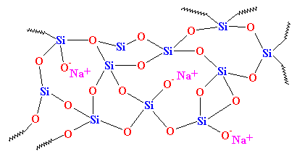
Glass

Slide 8
The Slide, Wax Paper, and Capillary Tube
As we’ve already learned, water adheres to glass
The water “spreads” and “climbs”—the climbing is called capillary action
Water does not adhere to wax
The wax molecules do not interact with the water molecules

Slide 10
Surface Tension
Surface tension, a well-known property of water, is explained by cohesion
The “tension” comes from water molecules sticking to one another
Hydrogen bonding!
This is why you get a “dome” on the penny

Slide 11
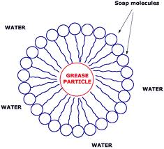

Slide 12
Detergents
Soap reduces surface tension
The non-polar tail of the molecule is described as hydrophobic
Does not like water!
The polar head of the molecule is described as hydrophilic
Likes water!

Slide 13
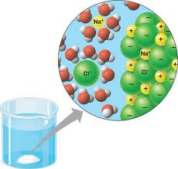
The polar water molecules surround the ions

Slide 14
Solutions
Water has negative and positive charge, and so does salt
This means that the water can interact with the salt
Iodine has no charge, so it does not dissolve in water
Oil is non-polar
Oil has no charges, so it cannot interact with salt

Slide 15
Heating Up Slowly
Water heats up much more slowly than most liquids
It takes considerably more energy to get water to 100°C than it does to get oil to 100°C
The amount of energy required to increase the temperature of a substance by one degree is called specific heat
Water has a remarkably high specific heat

Slide 16
Specific Heat (cont.)
Water’s high specific heat is explained by the hydrogen bonds
Although one hydrogen bond is relatively weak, remember that many of them together are strong
Heating up water requires breaking up those hydrogen bonds, which takes a lot of energy

