Slide 1
The Catalase Lab—“What were we supposed to see, anyway?”

Slide 2
The Reaction
H₂O₂→H₂O + O₂ (gas)
The conversion of hydrogen peroxide to water and oxygen is achieved by the enzyme catalase
As the reaction progresses, more and more oxygen is produced
This means that measuring the amount of oxygen can give you an idea of the reaction rate

Slide 3
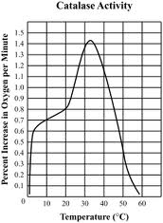
Temperature

Slide 4
Temperature
As the temperature increases from room temperature, the reaction rate also increases
At some point, however, the increase in temperature becomes detrimental and the reaction rate will begin to decrease dramatically as temperature increases
For catalase, this happens around 35°C
Each enzyme has a unique temperature range
High temperatures cause the enzyme to denature
The protein unfolds and loses its special 3D shape

Slide 5
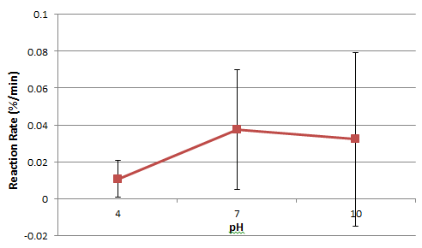
pH

Slide 6
pH
Every enzyme has an optimal pH range
For catalase, a pH around 7 (neutral) is best
A pH that is outside of the optimal range will disrupt the enzyme’s shape (protein denatures)
What do you think the optimal pH range is for the digestive enzymes in your stomach?

Slide 7
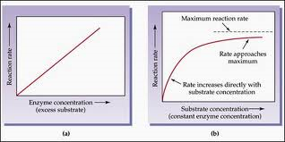
Substrate Concentration

Slide 8
Substrate Concentration
For a while, increasing the substrate concentration will increase the reaction rate
Eventually, the enzyme becomes saturated
This means that every enzyme molecule has a substrate in its active site—the reaction is occurring at a maximum rate
At the maximum, you can add as much substrate as you want, but the reaction cannot happen an quicker because all of the enzymes are already working

Slide 9
