Slide 1
Chemical Cycles

Slide 2
Nitrogen Cycle
Organisms need nitrogen (N) to make protein
Nitrogen exists in nature in many different forms
Free nitrogen in the atmosphere is N₂
Makes up about 70% of the atmosphere
Most organisms cannot use free nitrogen
Ammonia is NH₃
Nitrate is NO₃
Plants can use ammonia and nitrate

Slide 3
Nitrogen Cycle
Nitrogen fixation: turning free nitrogen into usable molecules, like ammonia (NH₃) and nitrate (NO₃)
Usually done by bacteria in the soil
Plants will use the nitrogen compounds from the soil
Consumers get the nitrogen compounds from producers
Denitrification: Decomposers break down the nitrogen compounds and place free nitrogen back into the atmosphere or soil

Slide 4
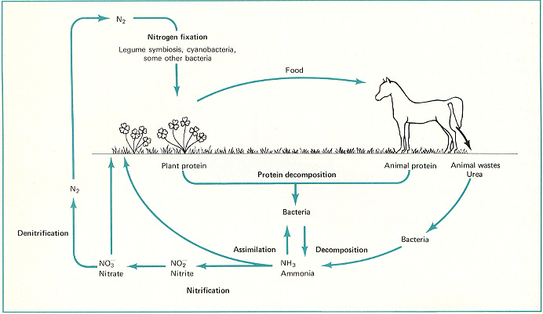

Slide 5
Carbon Dioxide and Oxygen Cycle
CO₂ and O₂ are found in Earth’s atmosphere
Plants take in CO₂ during photosynthesis and release O₂
Animals take in O₂ during cellular respiration and release CO₂

Slide 6
Carbon Dioxide and Oxygen Cycle
Plants “breathe” the CO₂ that animals release, and animals breathe the O₂ that plants release
Decomposers break down dead organisms and release carbon back into the earth
Burning fuel, fires, and volcanoes also put carbon dioxide back into the atmosphere

Slide 7
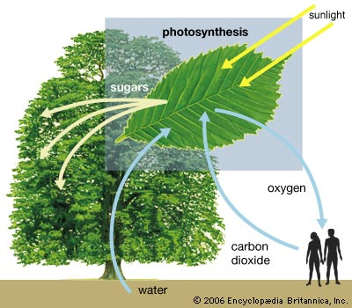
Cellular respiration

Slide 8
Photosynthesis
CO₂ + H₂O + light energy → C₆H₁₂O₆ + O₂
Carbon dioxide
Glucose (sugar; food source)
Water
Oxygen
Cellular Respiration
C₆H₁₂O₆ + O₂ → CO₂ + H₂O + energy
Carbon dioxide
Water
Glucose (sugar; food source)
Oxygen

