Slide 1
12/15/11
Objective: Recognize that cellular respiration is a series of pathways used to harvest energy from carbohydrates
Warm-Up: How is energy put into an ATP molecule? How is energy released from an ATP molecule?

Slide 2
Homework—to be collected on Tuesday, 12/20
Create a graphic organizer to help you keep track of cellular respiration.
It can be a table, a chart, a concept map—whatever works for you.
Needs to cover, at minimum: location, inputs, and outputs for glycolysis*, Krebs cycle*, electron transport chain, and fermentation

Slide 3
Cellular Respiration

Slide 4
Cellular Respiration Overview
C₆H₁₂O₆ + 6O₂ →6 CO₂ + 6H₂O + energy
Carbon dioxide
Water
Glucose
Oxygen
*Page 141 in your text has a decent visual summary of the entire process

Slide 5
Cellular Respiration Overview
Process of converting the chemical energy that is stored in glucose into ATP
Respiration has both an aerobic pathway and an anaerobic pathway
In aerobic respiration, oxygen is reduced to form H₂O
The anaerobic pathway is called fermentation and is less efficient—produces less ATP—than aerobic respiration

Slide 6
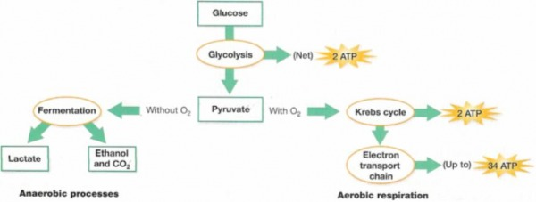

Slide 7
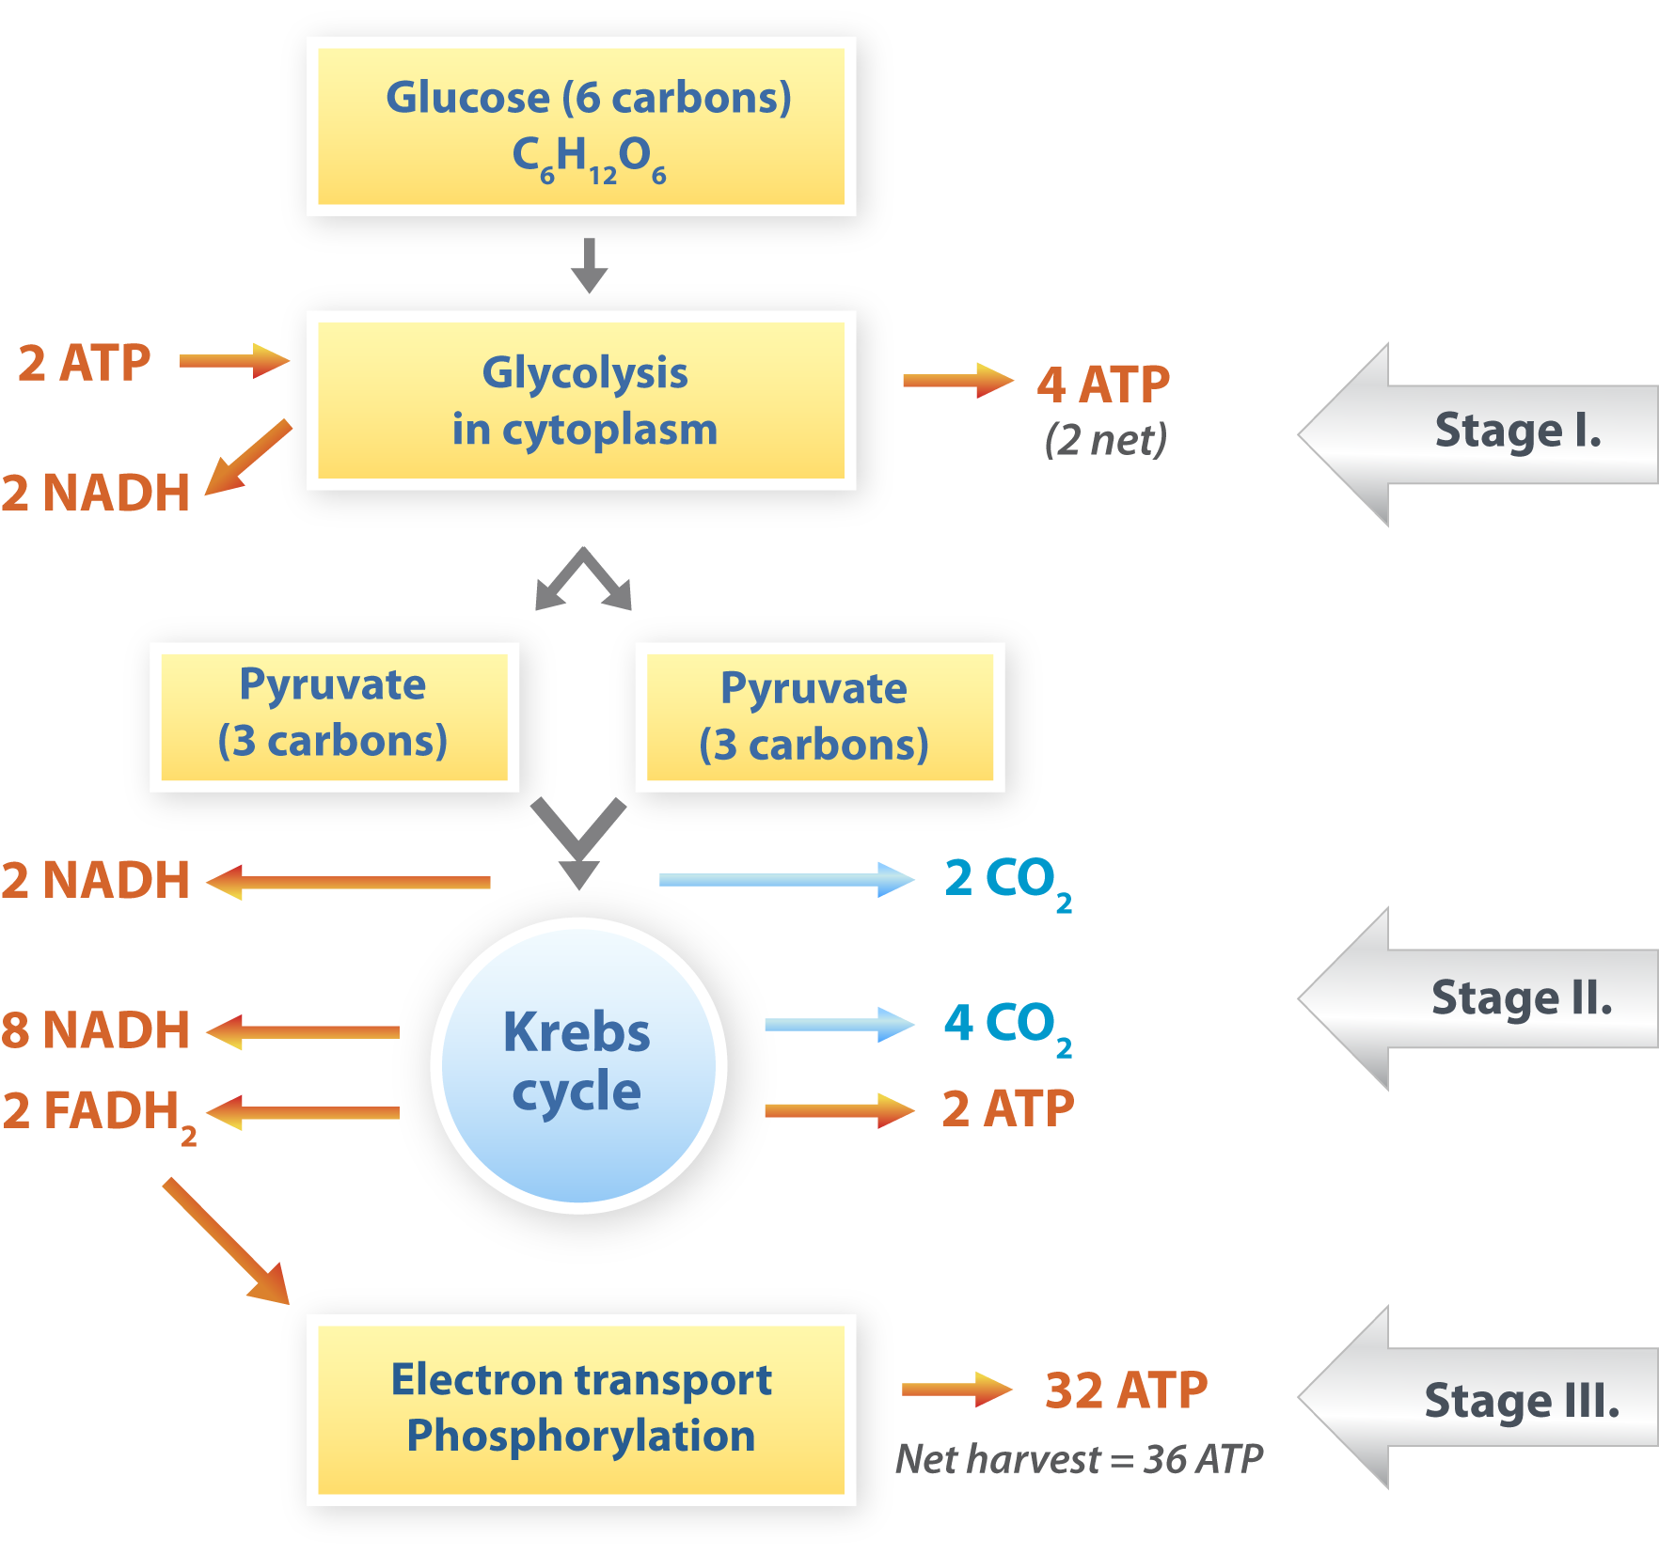
6 NADH
Electron Transport Chain

Slide 9
Glycolysis
Takes place in the cytoplasm
“Gly—” means sugar, “lysis” means to break apart
Glycolysis is the splitting of glucose into 2 three-carbon molecules called pyruvate
It requires an investment of 2 ATP
Produces 4 ATP (for a net gain of +2 ATP!) and 2NADH (reduced electron carriers)
Anaerobic

Slide 10
Glycolysis (cont.)
The ATP produced during glycolysis is synthesized through a process called substrate-level phosphorylation
This means that a phosphate group is taken off of a substrate and transferred directly to ADP

Slide 11
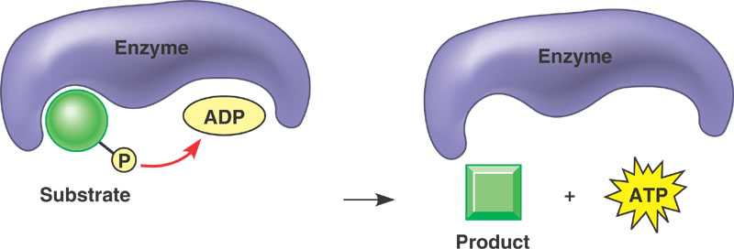

Slide 12
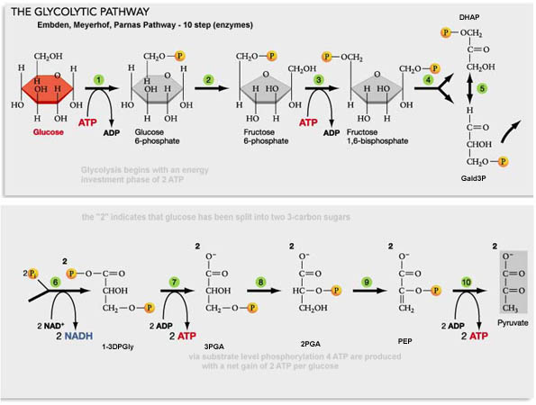

Slide 13
The Krebs Cycle (aka the Citric Acid Cycle)
Takes place inside the mitochondria
Starts with pyruvate from glycolysis
Pyruvate undergoes a series of chemical transformations
3CO₂ are produced as a result
Remember that there are two pyruvates for each glucose, so there are 6CO₂ for every 1 glucose
Reduced electron carriers: 4NADH, 1 FADH₂
1 ATP

Slide 14
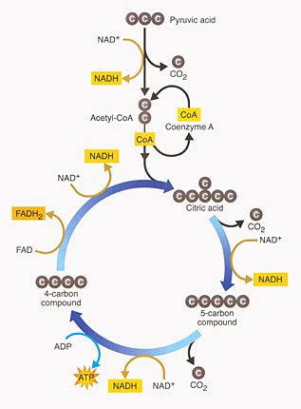

Slide 15
Electron Transport Chain
Inner membrane of mitochondria
Powered by the hydrogen atoms from FADH₂ and NADH
This is the only phase of cellular respiration that is truly aerobic
It produces the bulk of the ATP—about 34 molecules of ATP for each molecule of glucose

Slide 16
Electron Transport Chain
Electron transport chain proteins embedded in the mitochondrial membrane oxidize FADH₂ and NADH
The H atoms are split into electrons and protons
The electrons move through the chain and are eventually transferred to O₂
The reduction of O₂ creates H₂O as a by-product
The movement of electrons powers proton pumps in the membrane

Slide 17
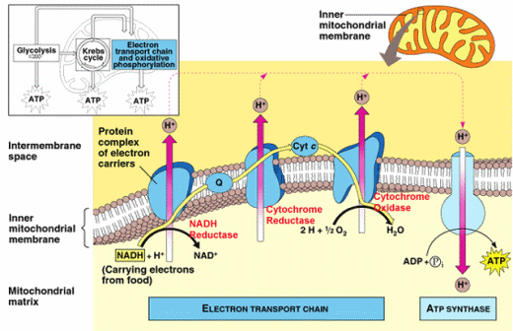

Slide 18
Electron Transport Chain (cont.)
Protons become highly concentrated in the intermembrane space of the mitochondria
Protons move down their concentration gradient through ATP synthetase, powering the phosphorylation of ADP
This is called oxidative phosphorylation
Oxidative phosphorylation is significantly more efficient than substrate-level phosphorylation

