Slide 1
11/29/11
Objective: Understand the significance of homeostasis and describe mechanisms of homeostasis
Warm-Up: Is your heart rate always constant? Explain.

Slide 2
11/30/2011
Objective: Interpret diagrams of feedback mechanisms and explain how feedback is essential for homeostasis
Warm-Up: Test practice!
Using the concept of diffusion, explain what happens when you add a few drops of food coloring to a beaker of water.
If a substance is being transported against its concentration gradient, then the transport is:
A) Passive B) Active C) Not enough info to determine

Slide 3
Body Systems and Homeostasis

Slide 4
Homeostasis
Organisms need to maintain stable internal conditions within a controlled range
Why?
Homeostasis is really a state of dynamic equilibrium
The internal environment is always in flux
Cells and organisms are constantly responding to changes in their environments

Slide 5
Example: Heart Rate
Suppose you have a resting heart rate of 60 beats per minute (bpm)
As you’re sitting in class your heart might be going 63 bpm
During basketball practice, your heart could get up to 100 bpm
While you sleep, your heart could slow to 55 bpm

Slide 6
Example: Heart Rate
Although the heart rate is not constant, it is regulated
When you finish exercising, your heart rate doesn’t stay elevated—your body will slow it back down to your resting rate
When you wake up, your heart rate doesn’t stay low—your body will increase it in response to an increased demand for energy and oxygen
This is homeostasis! An elevated heart rate over a long period of time is dangerous—and so is a depressed heart rate over a prolonged period

Slide 7
Feedback
Homeostasis is maintained through complex systems of feedback regulation
Feedback regulation: occurs when the presence of one substance influences the level of another substance
Feedback allows cells and organisms to adjust their internal conditions based on information they receive from the surrounding environment

Slide 9
Questions to Answer
What is the effect of the hormome insulin?
What is the effect of the hormone glucagon?
What is the immediate effect of increasing blood glucose? How does this effect help maintain homeostasis?
What is the immediate effect of decreasing blood glucose? How does this help maintain homeostasis?

Slide 10
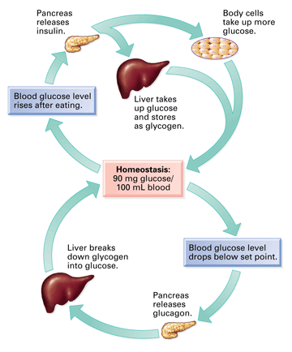

Slide 11
Feedback Example: Insulin, Glucagon, and Blood Glucose
Your body regulates your blood glucose level
After you eat a meal, your blood glucose level increases
The increase in glucose stimulates the pancreas to release insulin
Increase in insulin leads to an increase in the amount of glucose cells take in from the bloodstream
During this time, the liver is taking in glucose and converting it to glycogen for storage
Blood glucose level drops
The decrease in glucose causes the pancreas to secrete glucagon
Glucagon causes the liver to break down glycogen and release glucose

Slide 12
Questions to Answer for Calcium Example
What happens if levels of the hormone calcitonin increase?
How does the hormone PTH help the body adjust to low levels of blood calcium?
What stimulates the release of calcitonin?
What stimulates the release of PTH?

Slide 13
12/1/11
Objective: Understand the main function of the human body systems
Warm-Up: Test practice!
The phrase “water follows solutes” can be used to describe the movement of water during osmosis. Explain why.
Why do all living cells need ribosomes?

Slide 14
Types of Feedback
The glucose and calcium examples are negative feedback—the response to the stimulus decreases the original stimulus
Ex: increased blood glucose → increased insulin → decreased blood glucose
Positive feedback also exists, but it is much less common
In positive feedback, the response to the stimulus increases the original stimulus

Slide 15
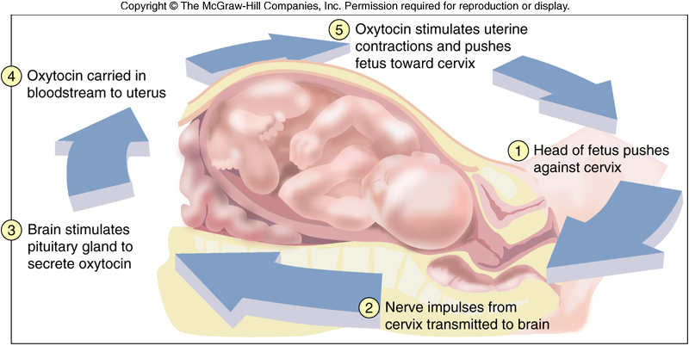
Positive Feedback Example: Childbirth
Pressure on the cervix stimulates the release of the hormone oxytocin
Oxytocin stimulates contractions, resulting in more pressure on the cervix
Pressure on the cervix stimulates the release of more oxytocin

Slide 16
Body Systems
One advantage of being multicellular is division of labor
Different cells can specialize for different functions
Cells similar in structure and function form tissues; tissues form organs; organs work together in systems
The organ systems work together to maintain homeostasis

Slide 17
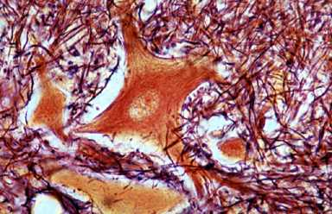
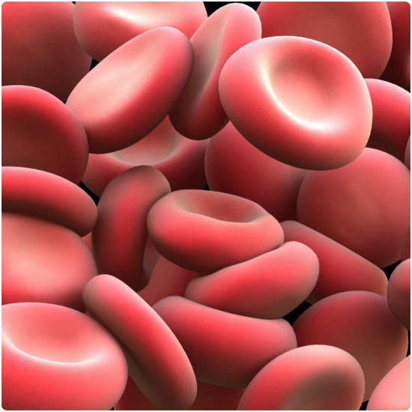
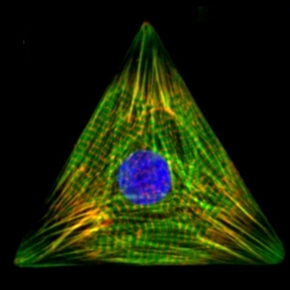

Slide 18
Endocrine System
System of glands and hormones
Hormone: a chemical signal produced by a cell or gland in one area of the body that affects cells or organs in a different part of the body
Some hormones are protein and others are lipids
Gland: an organ that produces hormones and secretes them into the bloodstream
Primary function: produce hormones that affect other parts of the body

Slide 19
Nervous System
System of spinal cord, brain, and neurons
Coordinates actions through the transmission of signals
Receives information from the environment
Transmits information from the environment to different parts of the body
Role in homeostasis: regulates heart rate, breathing rate, signals hunger/thirst

Slide 20
Circulatory System
Organisms need to transport materials to, from, and through cells
This system of blood vessels and the heart transports materials around the body
Oxygen, carbon dioxide, glucose, hormones, waste, etc.
Role in homeostasis: heart rate, O₂/CO₂ concentrations

Slide 21
Digestive System
System of mouth, esophagus, stomach, intestine, and related glands
Allows for the absorption of nutrients and water from food into the bloodstream
Role in homeostasis: supplies the energy and nutrients the body needs to keep functioning

Slide 22
Respiratory System
System of lungs, trachea, mouth, and nose
Responsible for gas exchange: bringing in O₂ and removing CO₂
Role in homeostasis: Maintaining O₂ and CO₂ concentrations

Slide 23
Excretory System
Organisms need to be able to remove waste
System of the kidneys, bladder, and urinary tract
Role in homeostasis: removing waste materials, maintaining H₂O concentration

